Slide 1
MULTI-TASKING APP
Presented By:
Ankita Agrawal (191500123)
Jyoti Agrawal (191500371)
Nandini Agrawal (191500477)

Slide 2
OUTLINE
What is Android Studio ??
About the project
Objective
Requirements
Implementation
Snapshots from the App
Conclusion

Slide 3
ANDROID STUDIO
Android Studio is an environment that helps us create and edit Android applications.
It is the official IDE for Android App Development.
It has intelliJ’s powerful code editor and developer tools and various features that enhance productivity while developing apps.

Slide 4
VERSION OF ANDROID STUDIO
Each year Android releases a new version with better features, better security and better User Interface experience, and a new symbol.

Slide 5
ABOUT THE PROJECT
Multi-Tasking App is an android app that helps users to access different mobile features through a single app.
This will be really helpful for the people who want to use the android mobile features in a very eye-catching and effective way.
The users just have to install the app through the use of the APK and then they can directly access the app on their android mobiles.

Slide 6
OBJECTIVE
User Friendly: The main objective of creating this app is to help the users to use the mobile features through a single app.
User Privacy: This app also helps the user in maintaining privacy to the mobile features as this app needs a user login id and password.
Proper Management: This can also help the user to solve the issue regarding the management of different mobile features.

Slide 7
REQUIREMENTS
Software Specification Used:-
Technology used: Android Studio
Language Used: Java
Database: Firebase
User Interface Design: GUI
Web Browser

Slide 8
Hardware Specification Used:-
Processor: Intel, Ryzen
Operating System: Windows, Linux
RAM: 4GB(minimum)
Hardware Devices: Android Mobile
Hard Disk: 32 GB(minimum in android mobile)

Slide 9
IMPLEMENTATION
We have the Login activity which consists of the following steps
Register: for new User
Login: For existing as well as a new user
We authenticate and store the user information from the Firebase authentication.
After this, the user can directly use the app.
Now you can enjoy the app.

Slide 10
THIS IS HOW OUR APP LOOKS
Hope you will like it :)

Slide 11
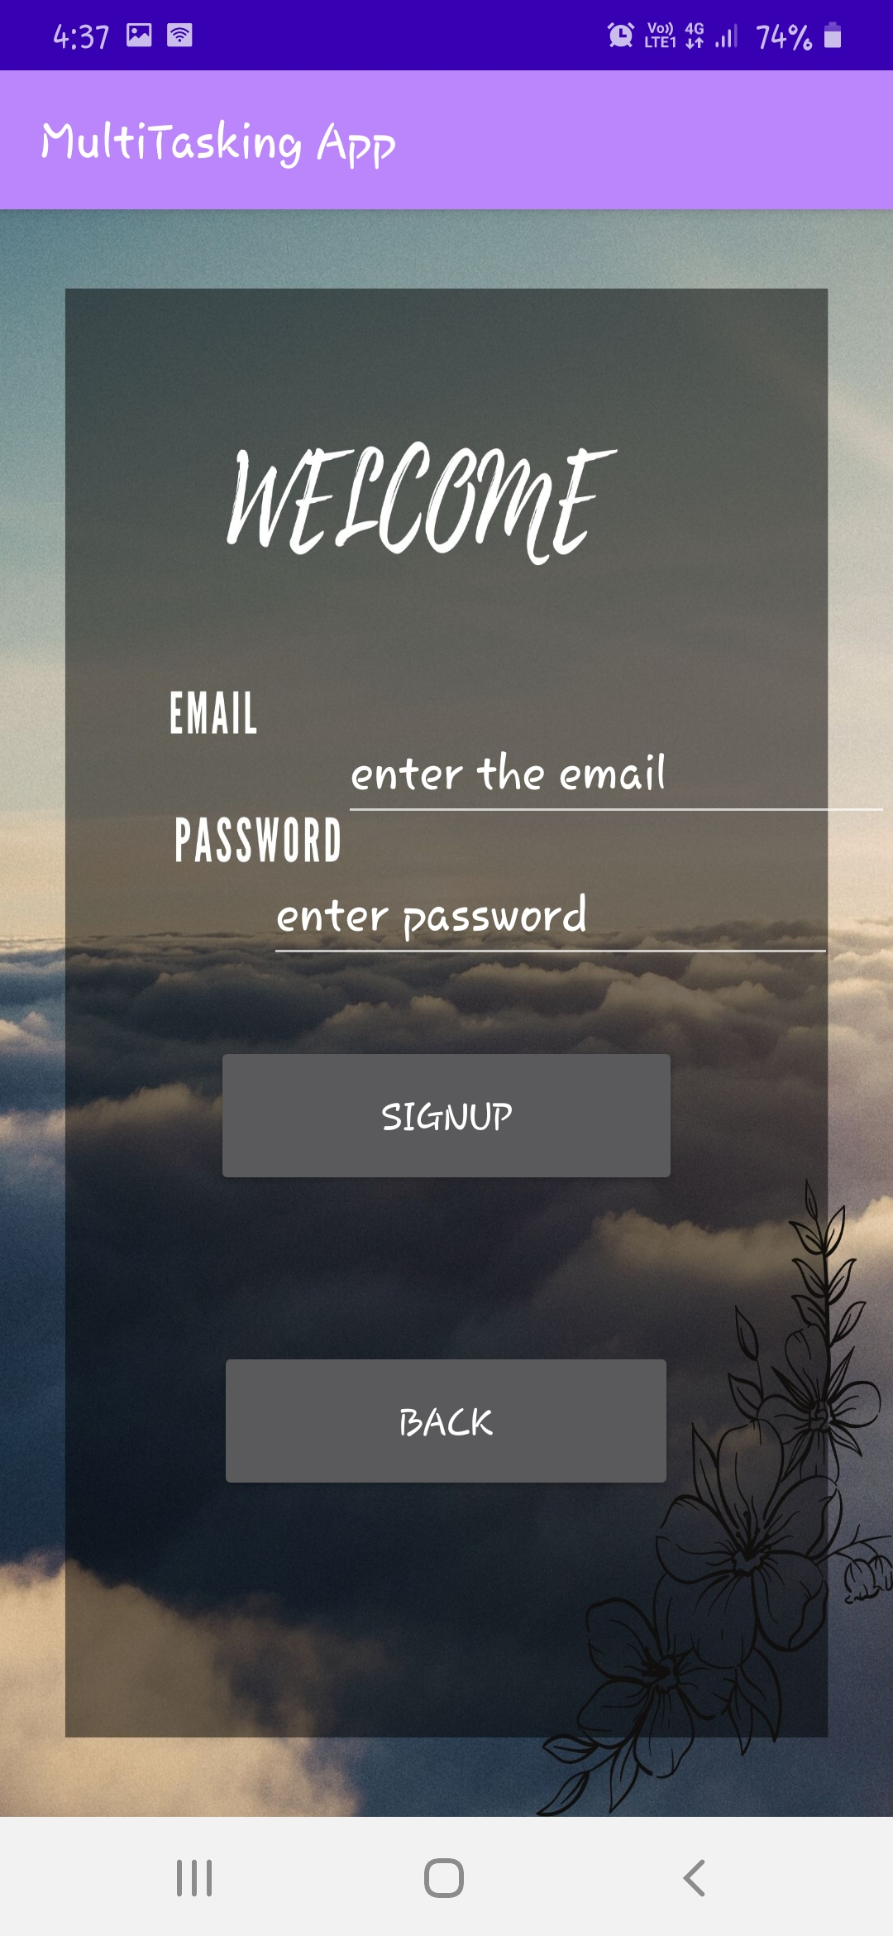
1. SIGN UP PAGE

Slide 12
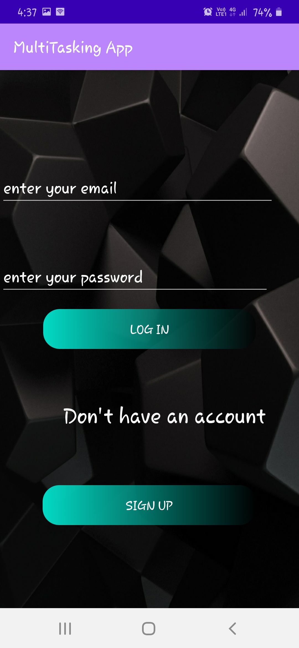
2. LOGIN PAGE

Slide 13
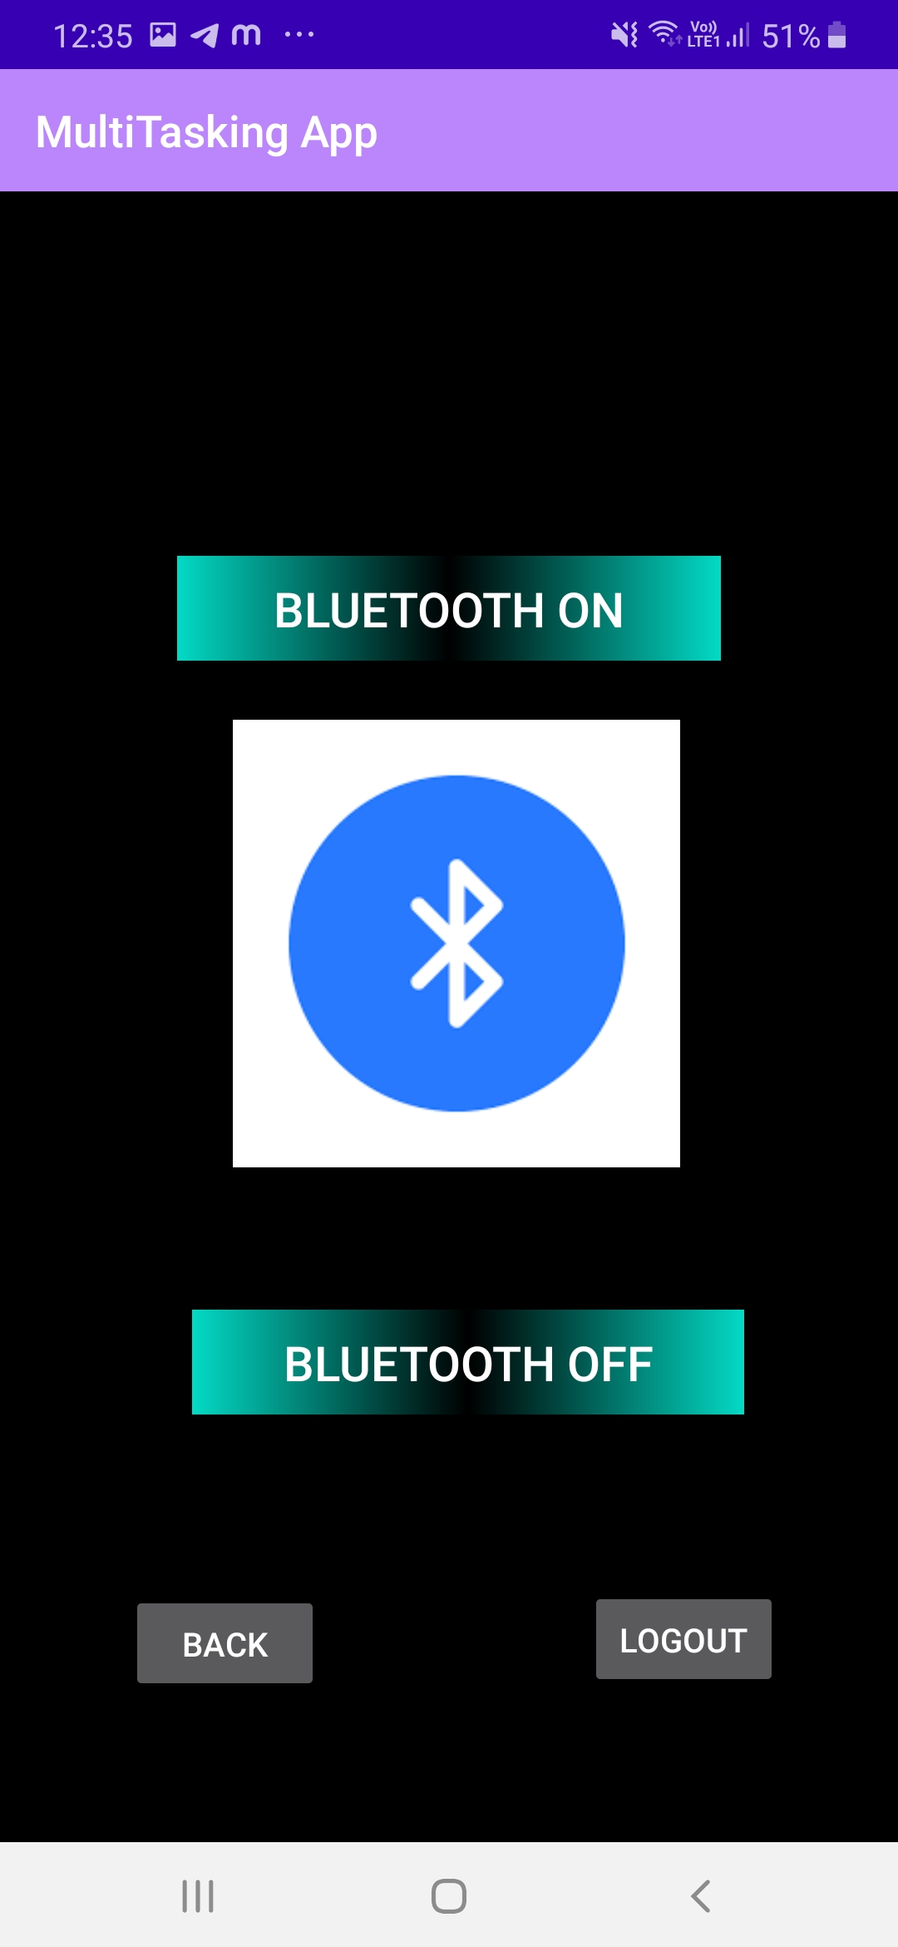
3. BLUETOOTH

Slide 14
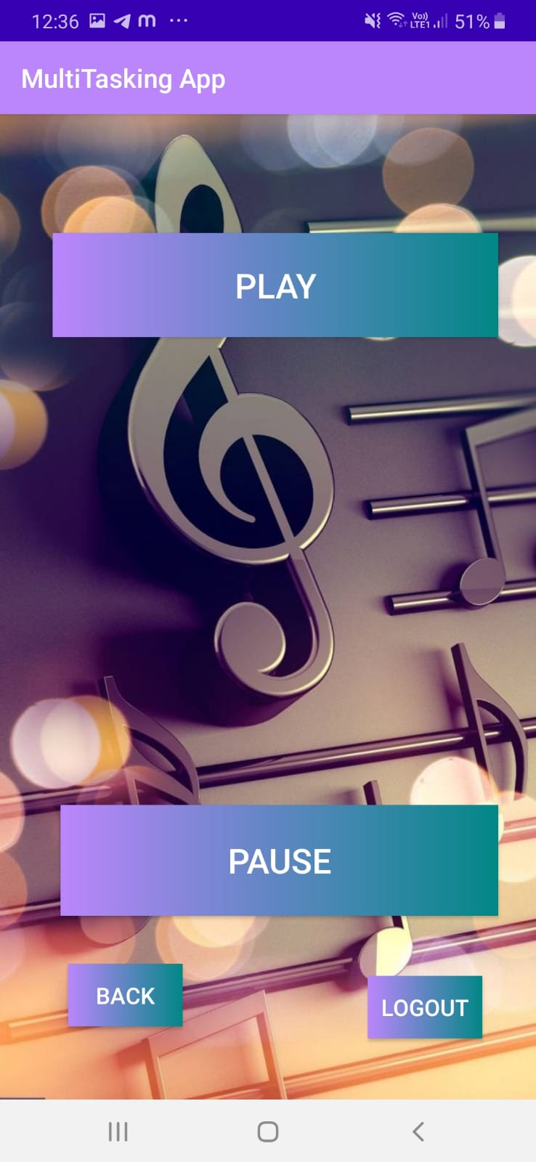
4. MEDIA PLAYER

Slide 15
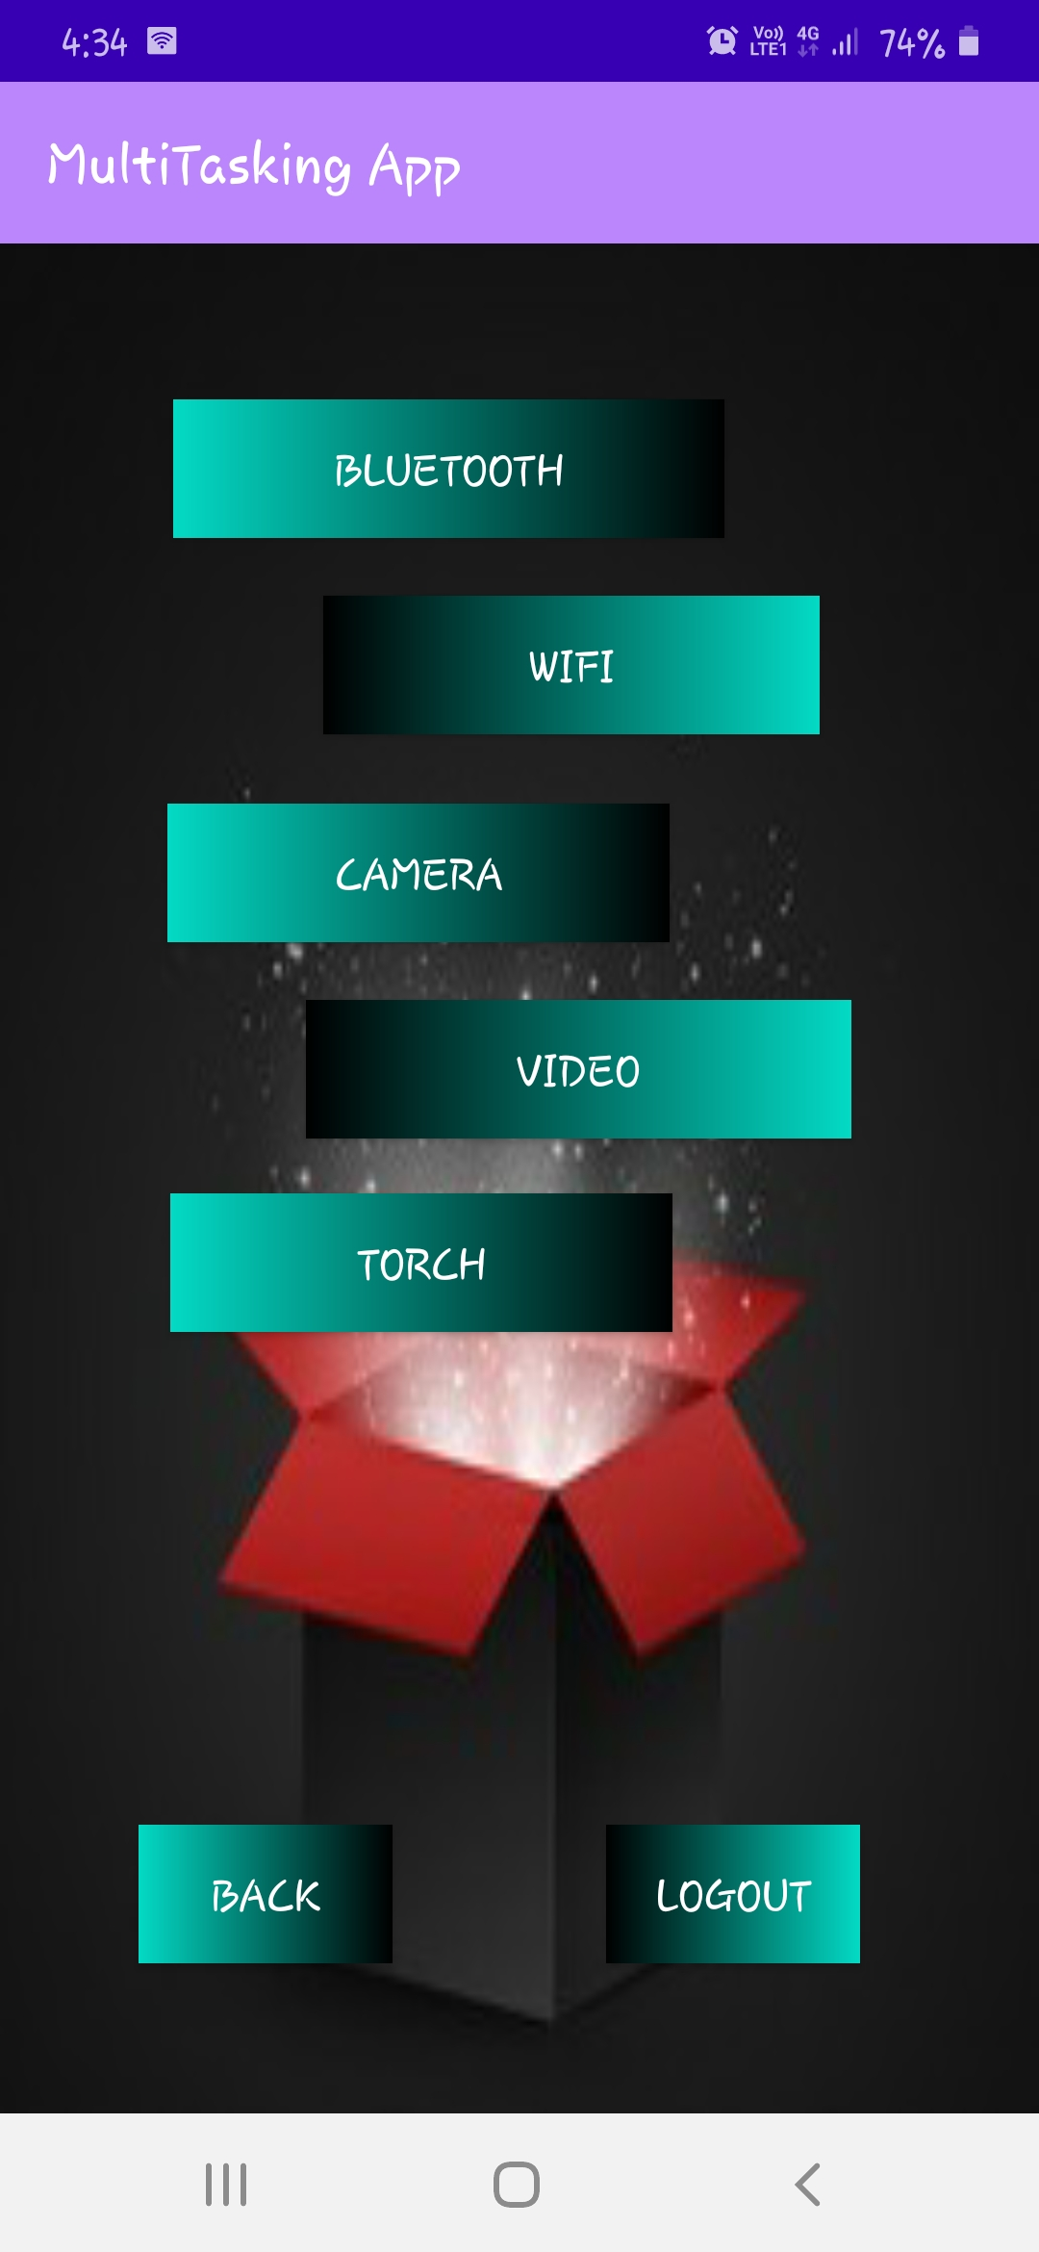
5. PHONE FEATURES

Slide 16
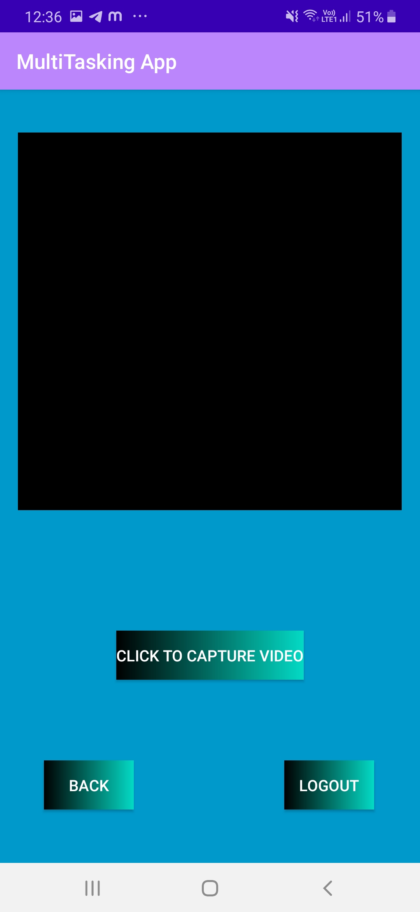
6. VIDEO CAPTURE

Slide 17
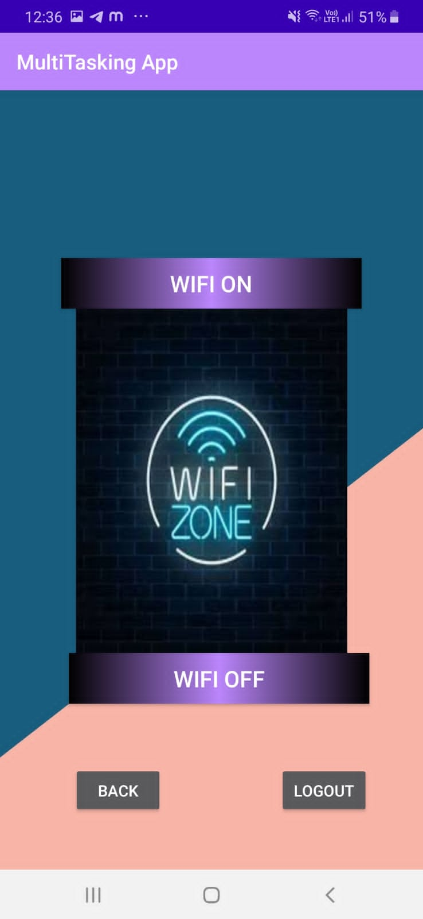
7. WI-FI

Slide 18
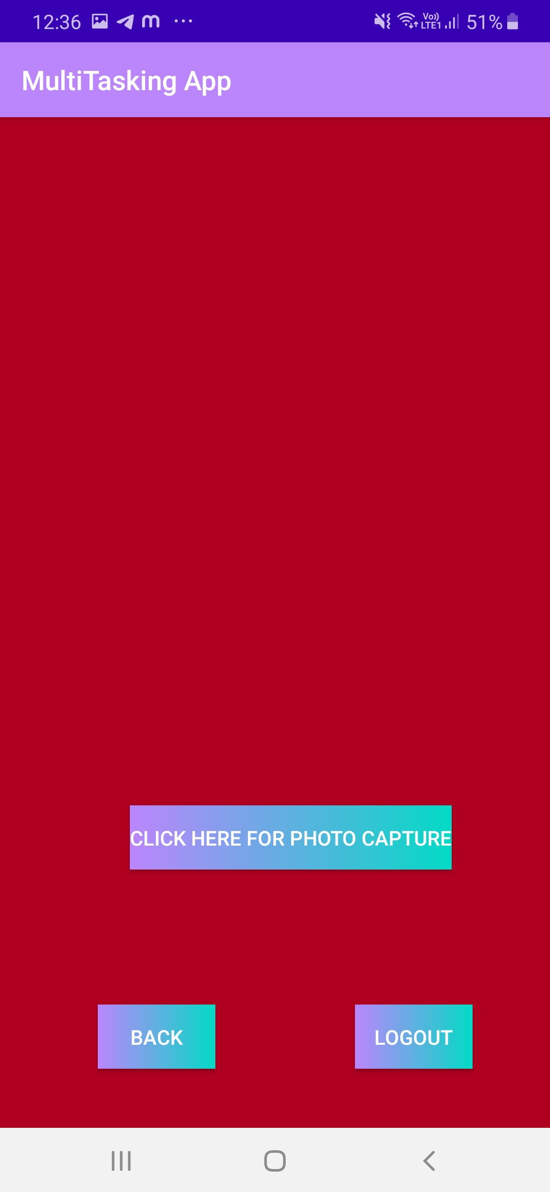
8. PHOTO CAPTURE

Slide 19
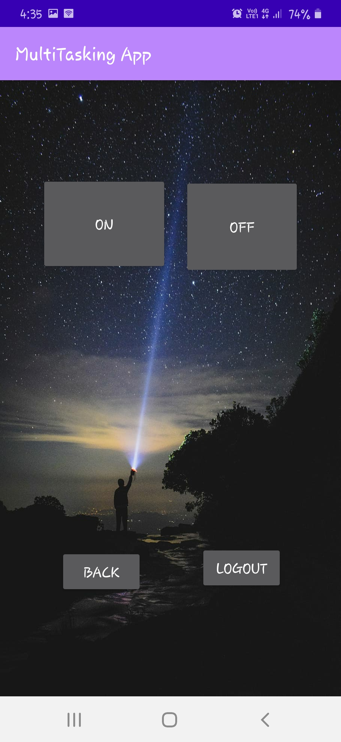
9. TROUCH

Slide 20
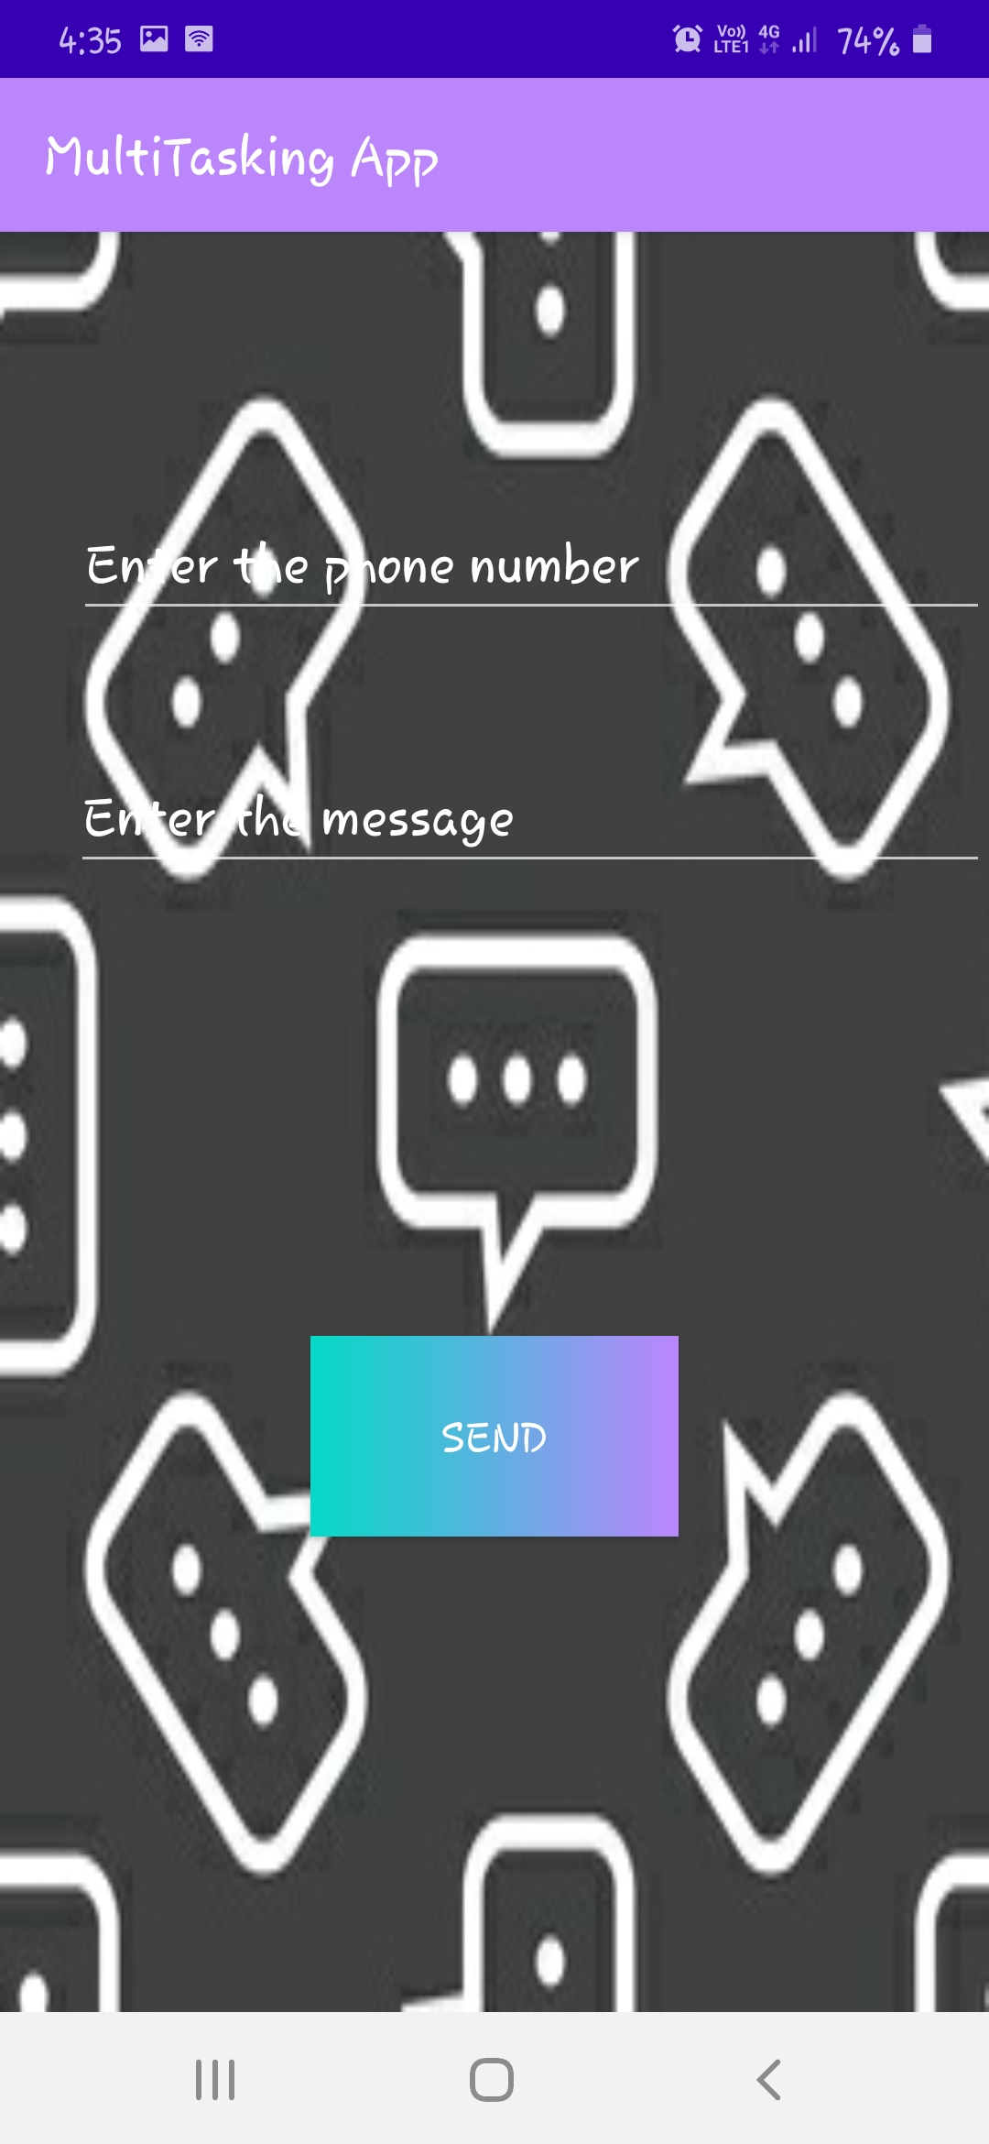
10. SMS FEATURE

Slide 21
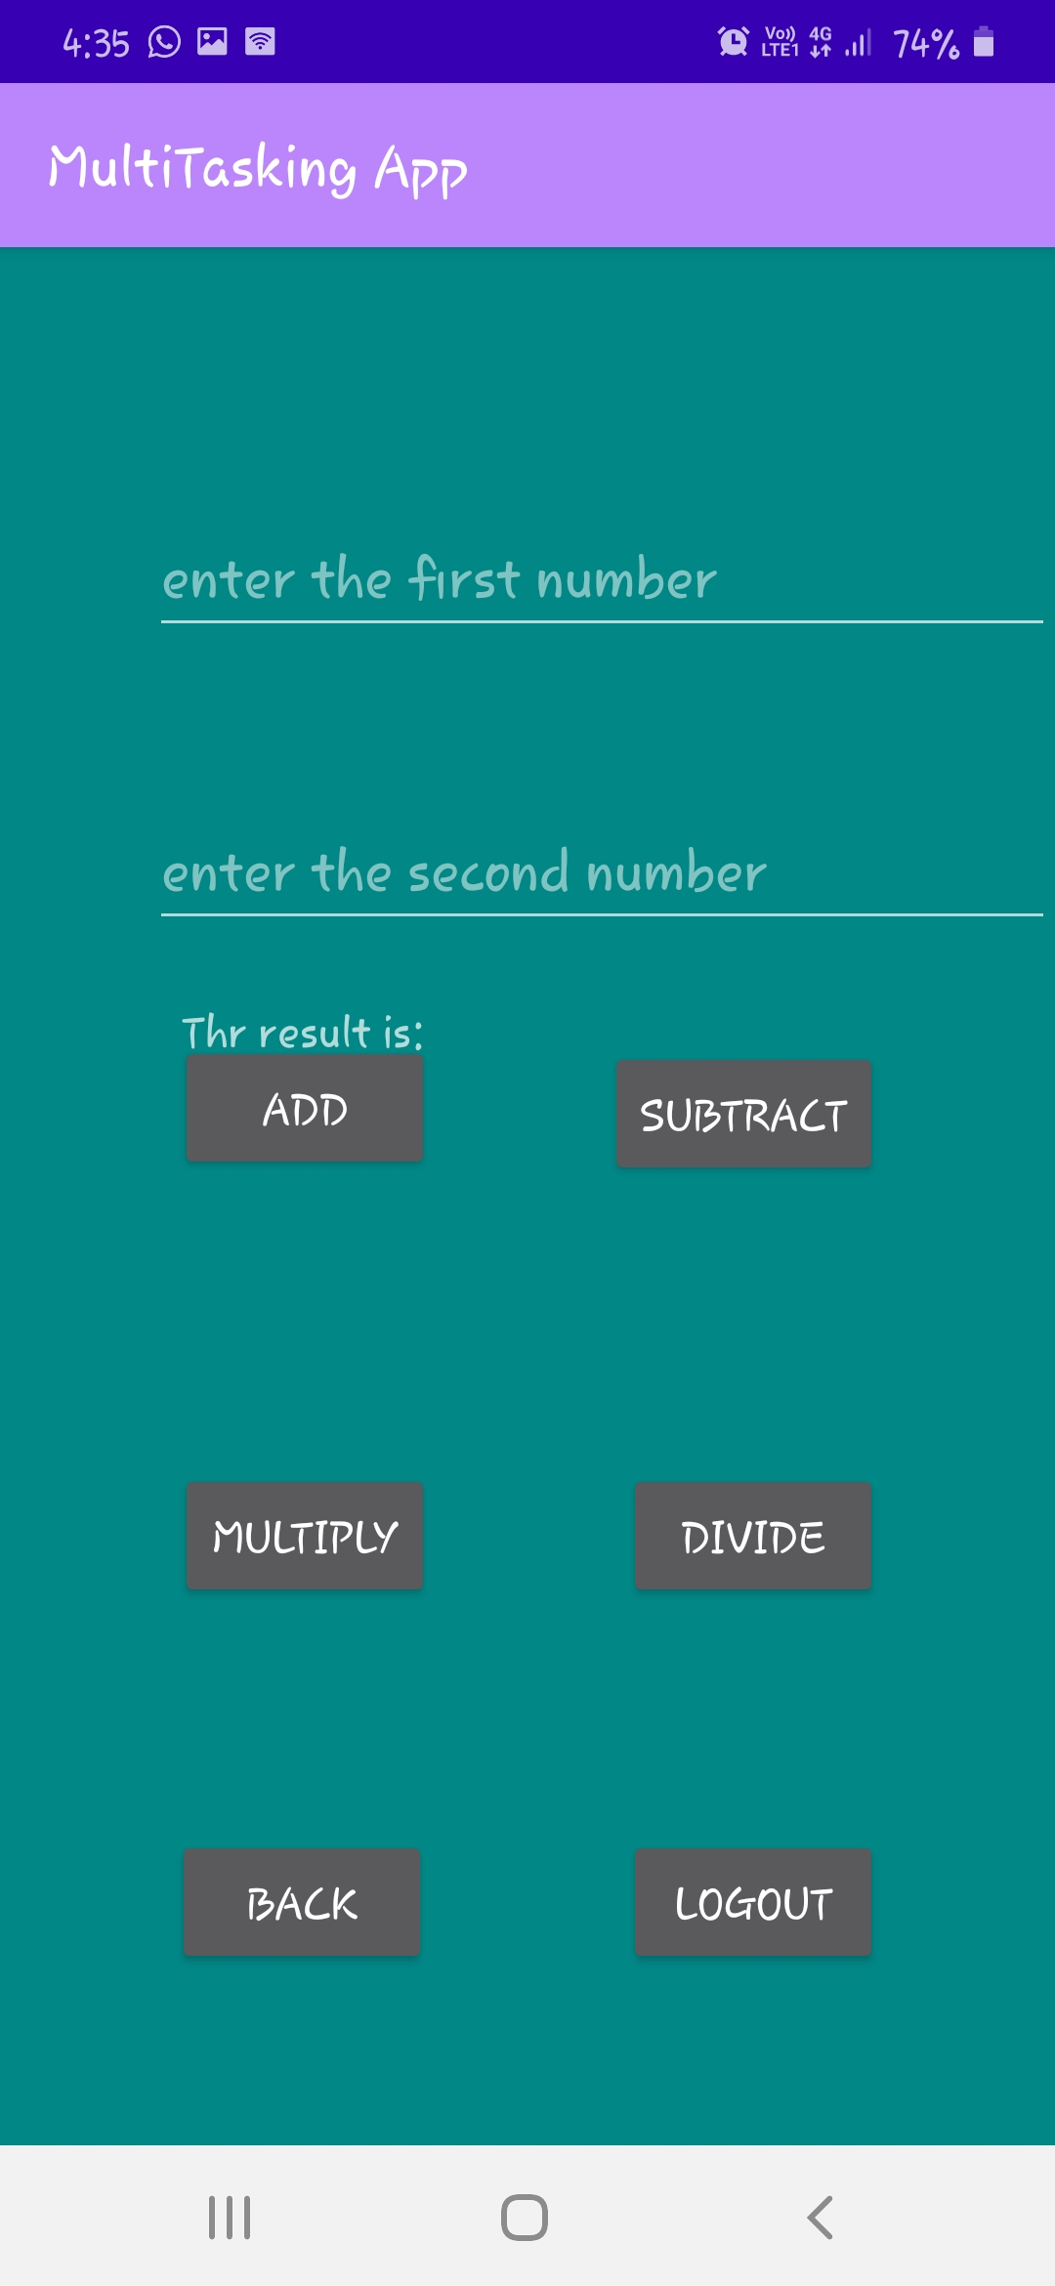
11. SMART CALCULATOR

Slide 22
CONCLUSION
The proposed Multi-Tasking App is an android application that will allow users to use all the applications in one app.
This application takes the data of the user to log in by which is also safe for the user to use the app. Users can access all the features of any android phone in one application and can also do chatting using the SMS application in the app.

Slide 23
This application has a wide range of scope in the upcoming era.
It is impossible to use all the features of the phone at once and also reduce the time and increase the efficiency of users.
People that have a hectic schedule in their daily life, can easily use this application and store data with privacy too as not everyone can access this data without login.

Slide 24
THANK YOU !!

